Slide 1
Predicting career paths for basketball players
O.R. Jozefzoon
Master thesis topic presentation
Msc Artificiall Intelligence

Slide 2
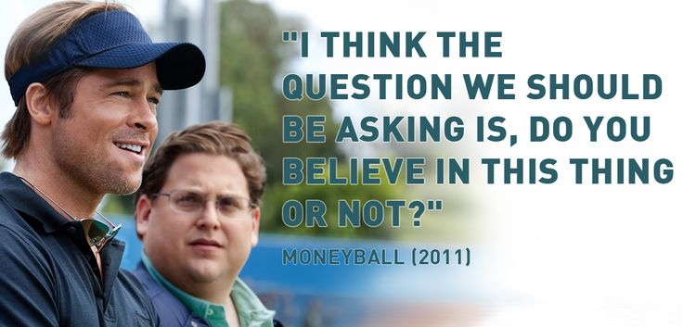
Background and motivation

Slide 3
Previous research
Baseball centered
Usage of statistical methods
Algorithms
MODEL TREES
SVM
RNN
BAGGING
BOOSTING
STACKING

Slide 4
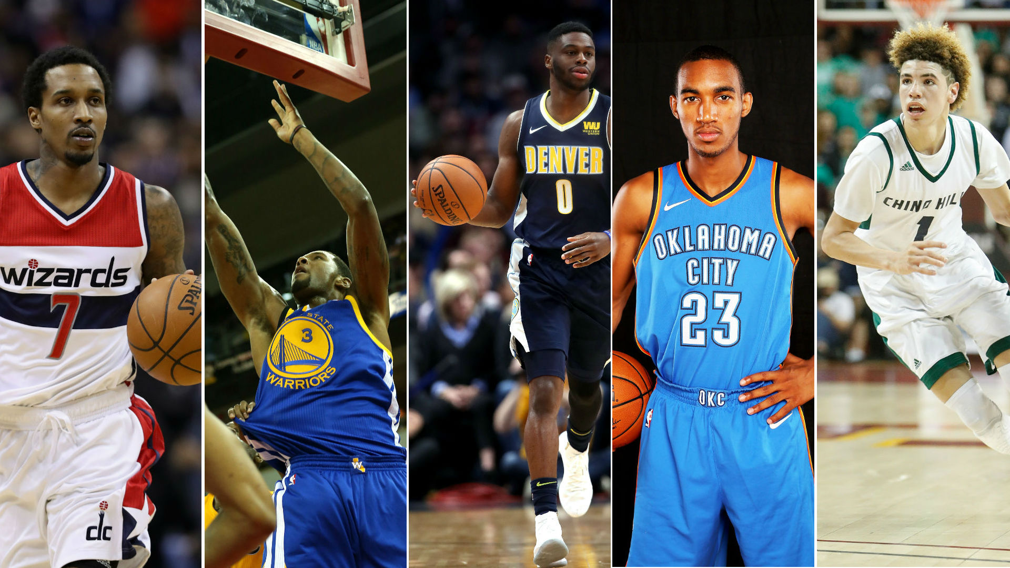
Predicting career paths for basketball players

Slide 5
Research question(s)
How accurate could the career path be predicted for an individual professional basketball player (ipbp)?
Provided the available data (from NBA and Euroleague), what is the accuracy of the prediction for a career path of an ipbp?
Using the results of the prediction of past career paths, is it possible to predict future career paths?
Which features from a given set are the most suitable to predict a career path?
Which algorithm fit the predictions the best, given the selected feature set?

Slide 6


Data
Source:
http://www.euroleague.net/
http://www.nba.com/
http://www.nbaminer.com/
Collected since 1950
Labels, categories:
Physical properties (height, weight, jump, …)
Personal properties (age, residence, …)
Player properties (Salary, draft year, rebounds… )

Slide 7
Methods
Sequence models (LSTM)
Time series

Slide 8
Evaluation
Similarity matching of players
Linear regression on yearly outcome

Slide 9
Questions/suggestions?

